Slide 1

HOF Prediction
Creators:
Moran De Porto
Eden Laor

Slide 2
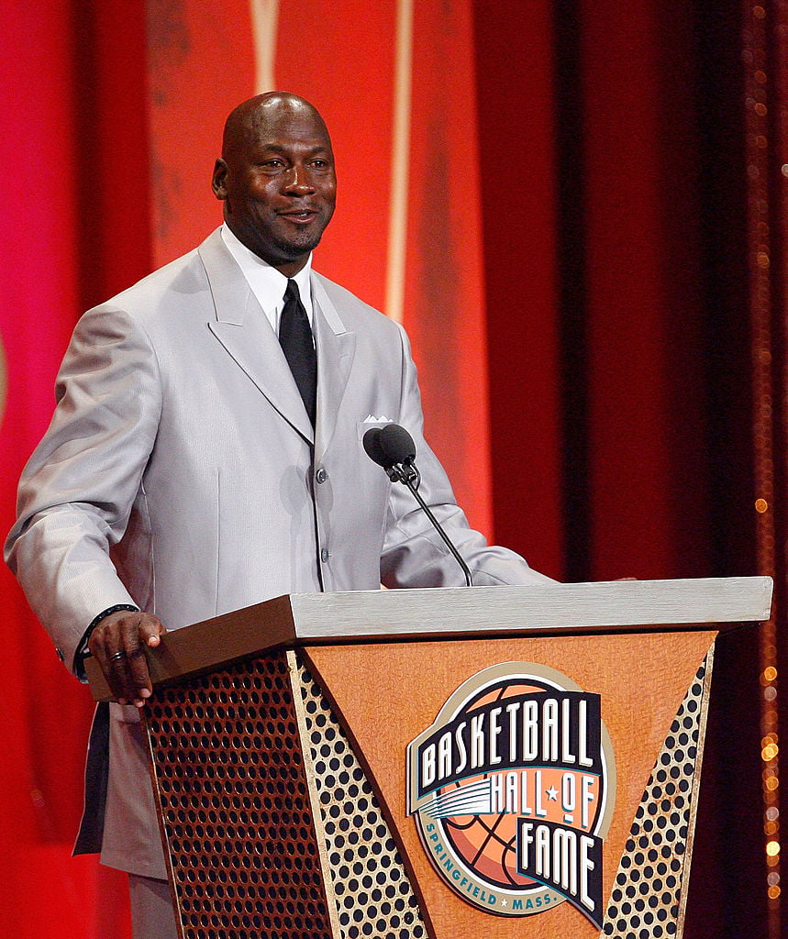
Table Of Contents
NOTE:
To change images on this slide, select a picture and delete it. Then click the Insert Picture icon
in the placeholder to insert your own image.
Data Collection
Data Cleaning
EDA Visualization
Machine Learning
Summary

Slide 3

Research Question:
Can we find out if an NBA player will be selected for the Hall of Fame list based on various characteristics (e.g. – points, assists, etc..)?

Slide 4
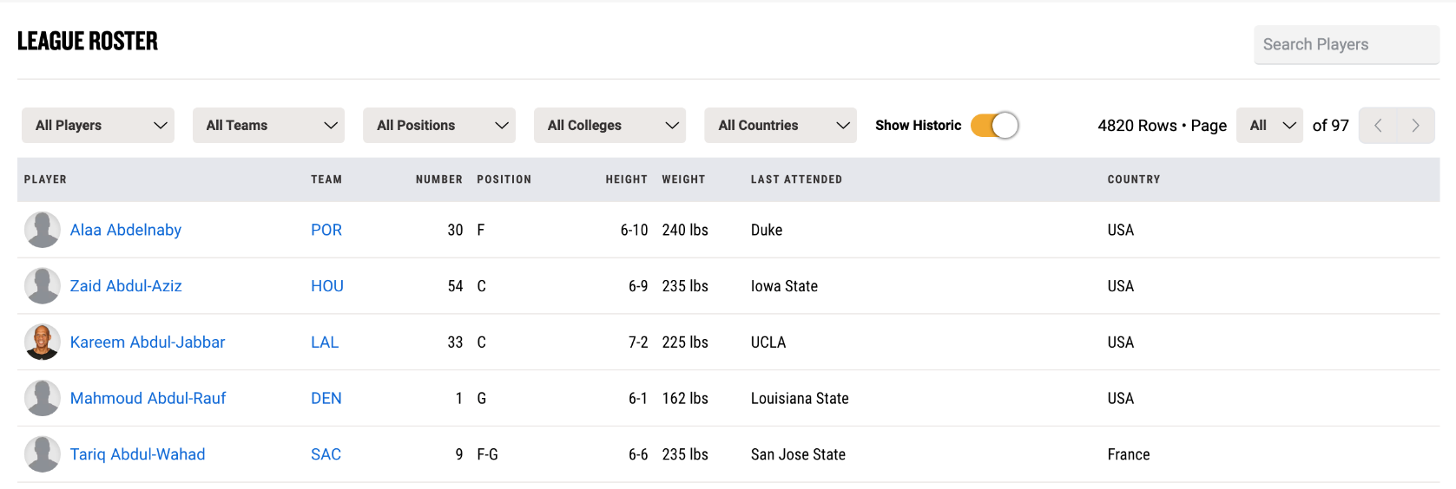
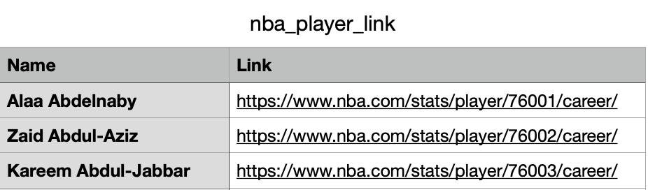


Data Collection
Data Source Example
Source: www.nba.com/players
Found that we needed to use the ‘Show Historic’ button and click on ‘All’ to show all players.
Used Selenium to do so. Extracted all the NBA players’ links to their data with their names to a CSV file using pandas.
CSV Data Example

Slide 5
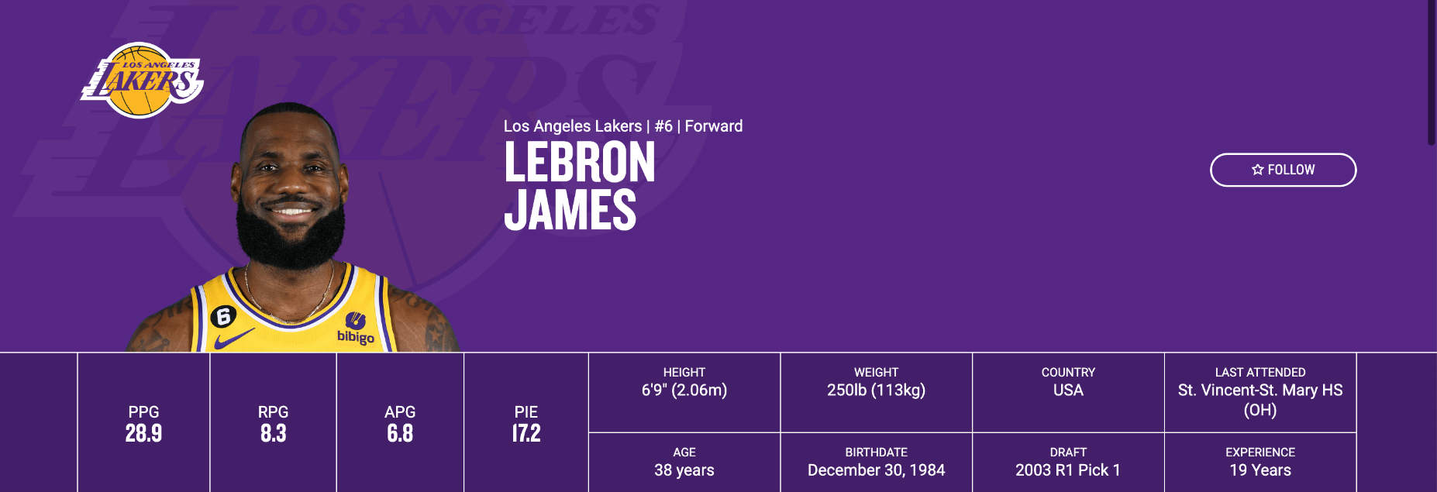
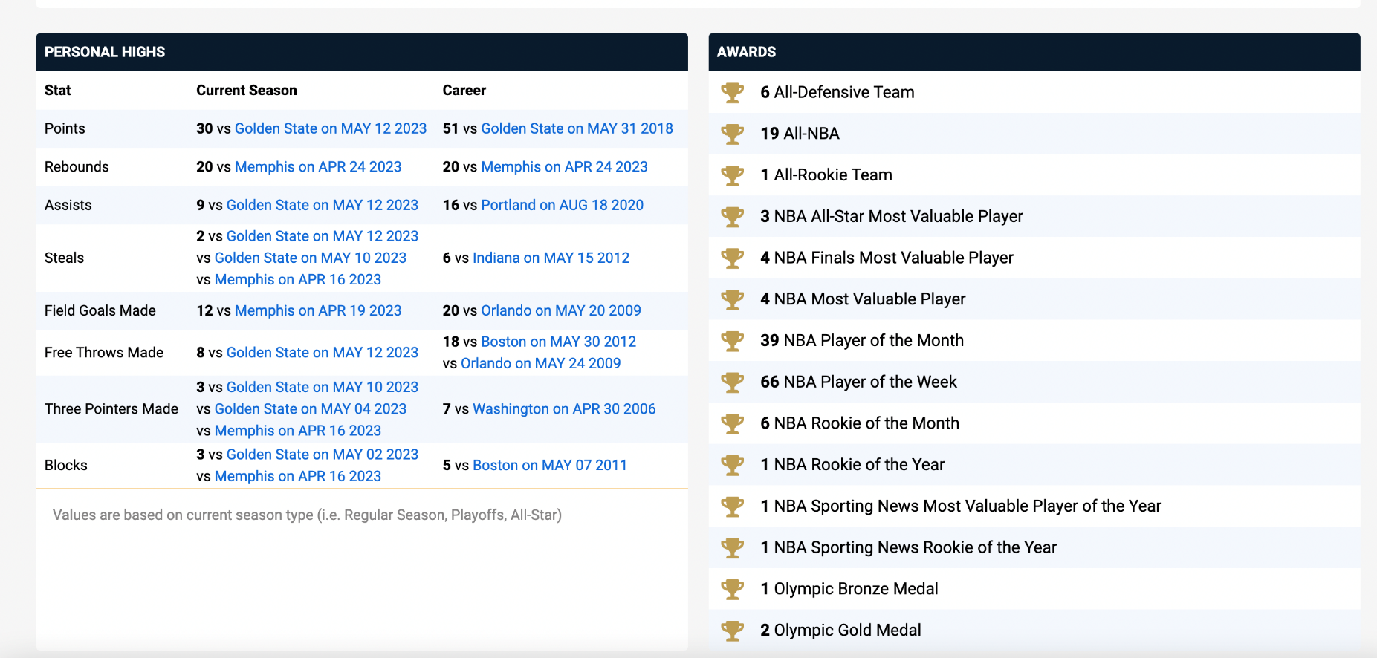

Data Source Example

Slide 6
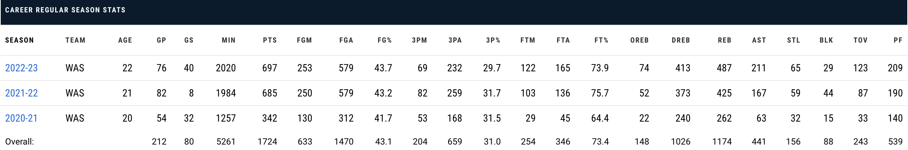


Data Source Example

Slide 7
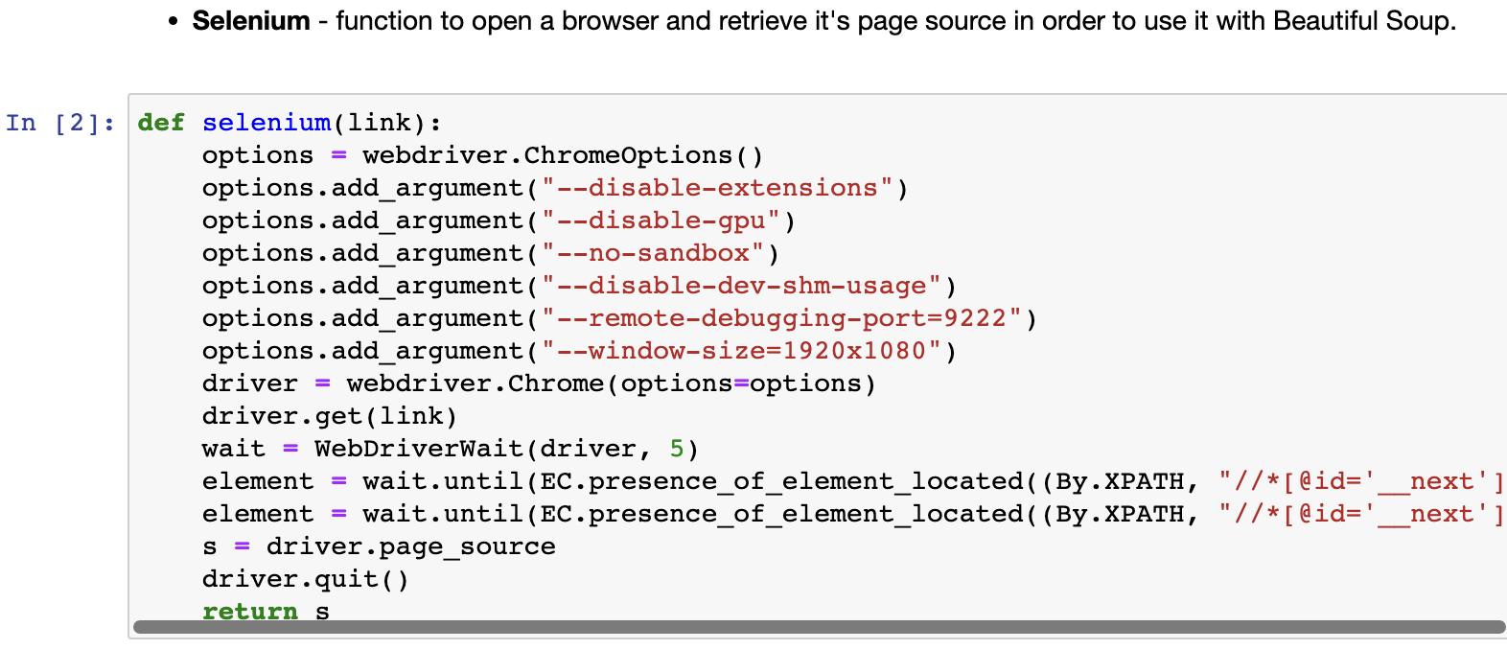
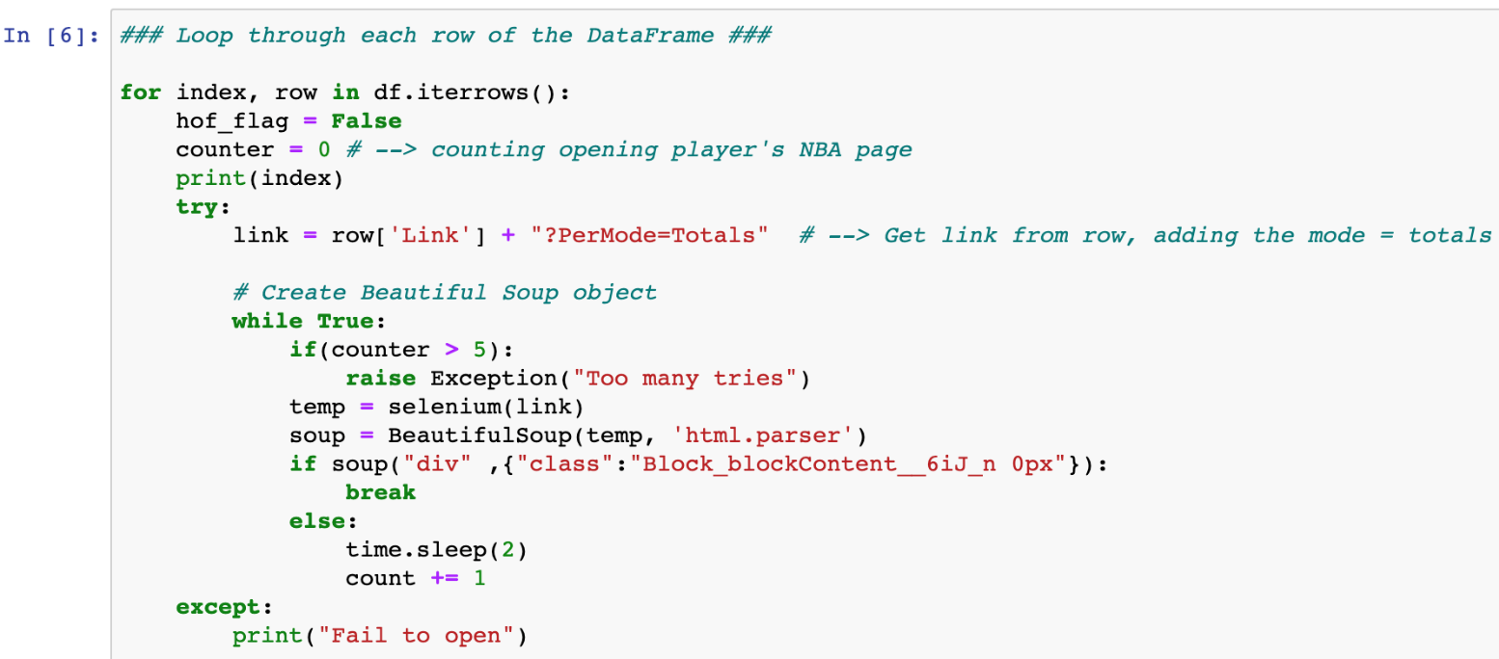
Crawling
Found that the page is dynamic (using JavaScript), so used Selenium to open the page and waited until all the necessary elements loaded. Returned the page source so we could use it with Beautiful Soup later.
Found that sometimes there was an issue loading the page on the 1st attempt (some data was missing, or the page just didn’t load at all) but it did load correctly after 2 or more attempts. Therefore, we allowed to attempt to load the page up to 5 times until it loaded correctly.

Slide 8
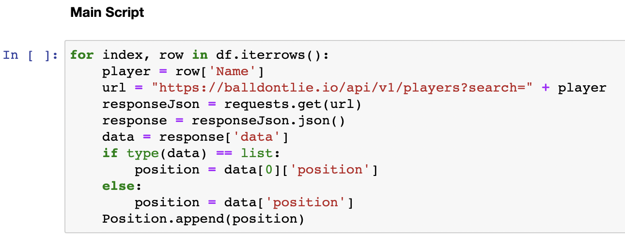
API Request
Found that there were positions only for active players on the NBA website (about 2%), so we used an API to get all the players’ positions.

Slide 9
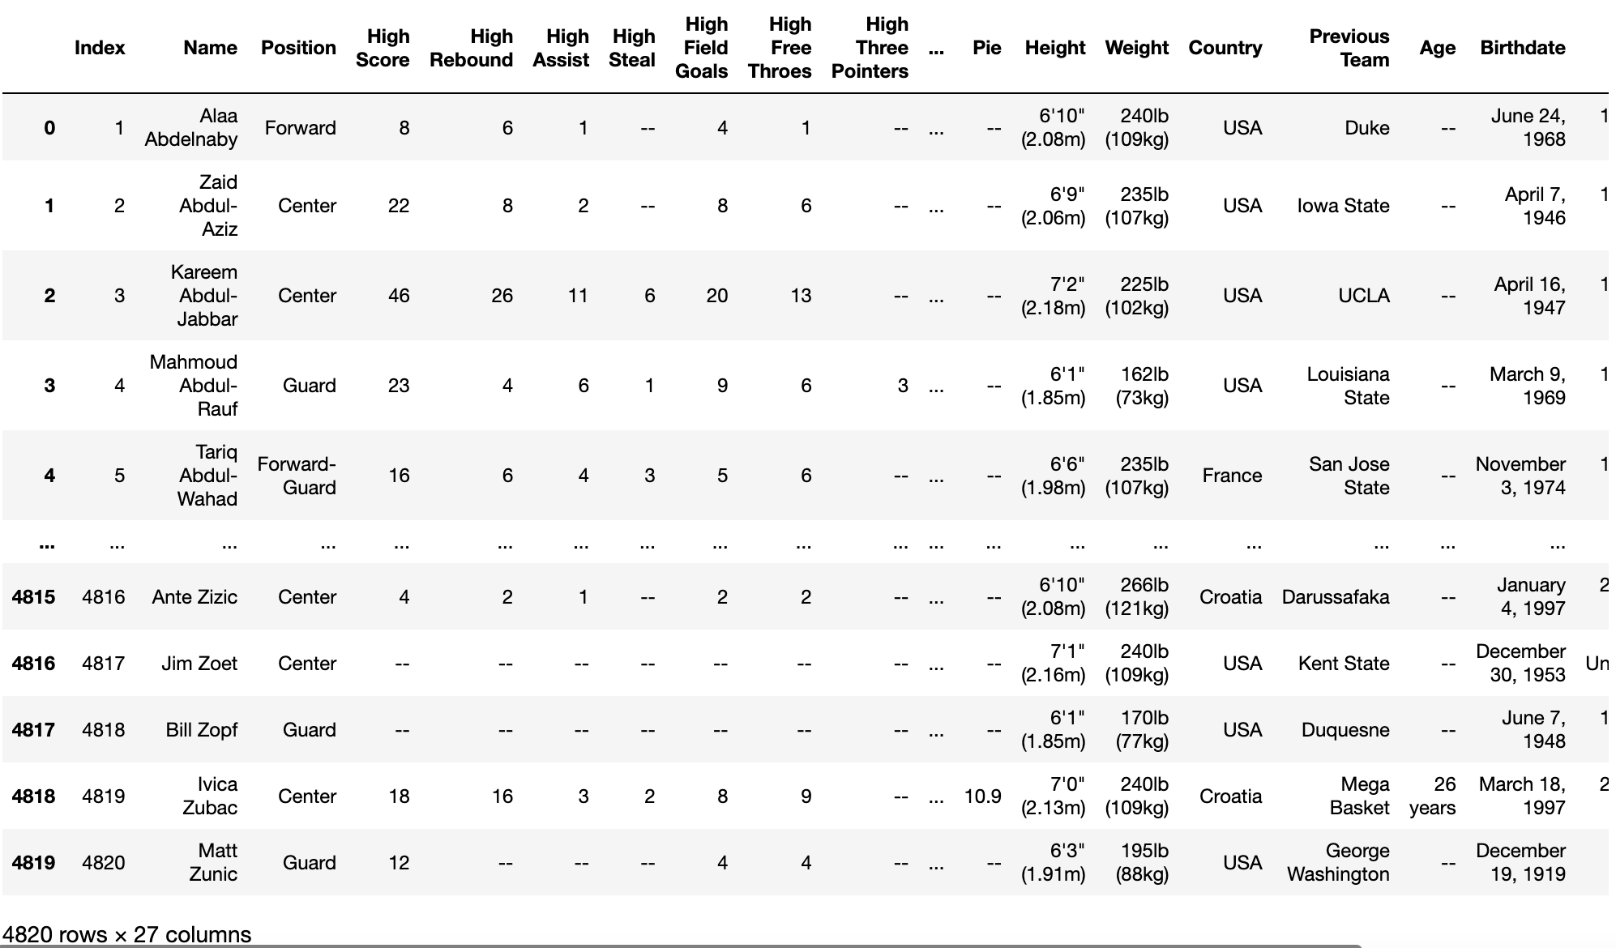
The DataFrame (before cleaning)

Slide 10

Data Cleaning
Converting string columns into numeric
Extracting relevant information from the existing columns
Filling and Removing missing values
Removed duplicated data
Handling outliers

Slide 11
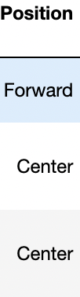
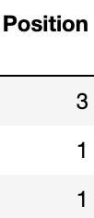
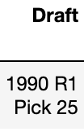
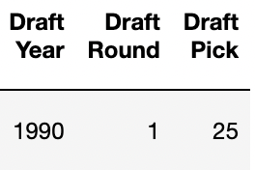
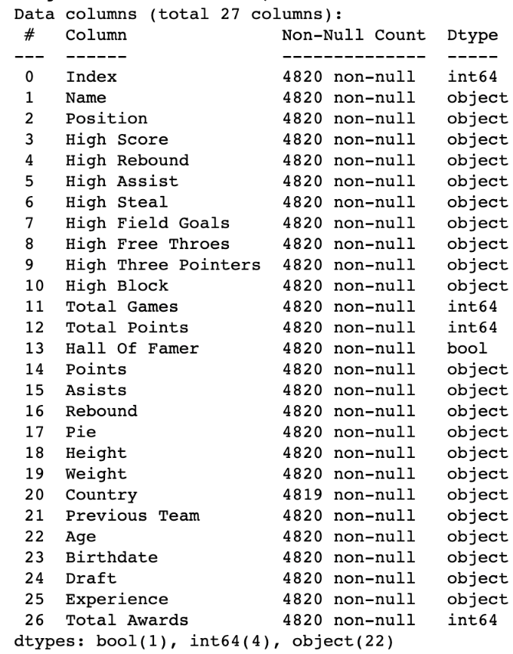
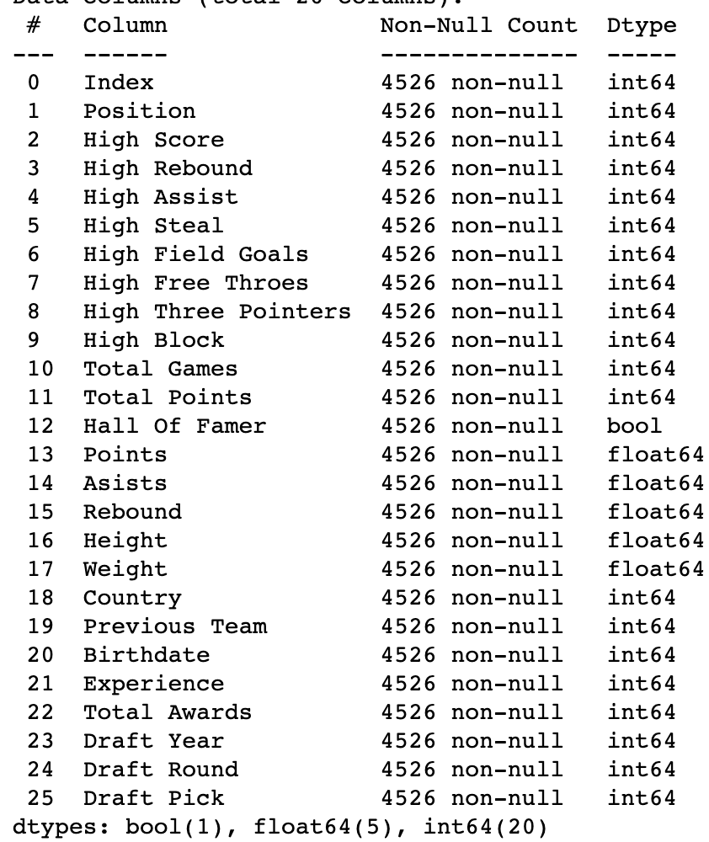
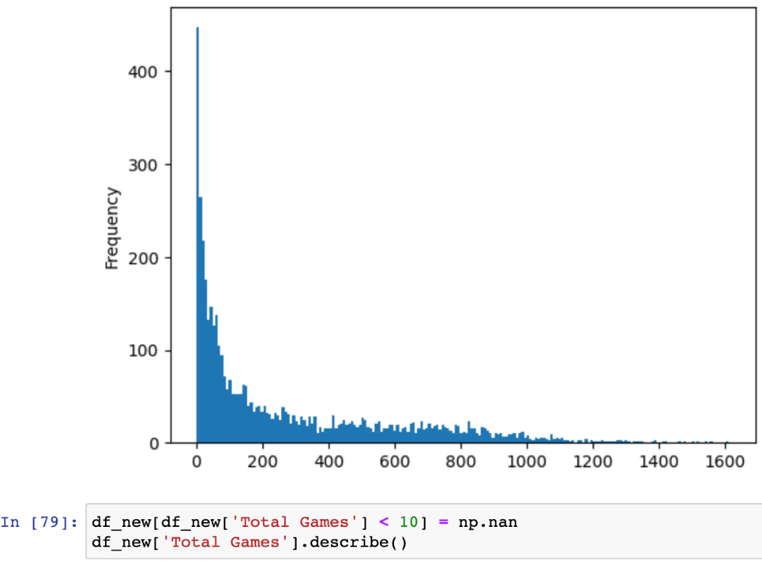
Examples:
Converting types
Extracting data from column
Before and After DataFrame
Outliers

Slide 12
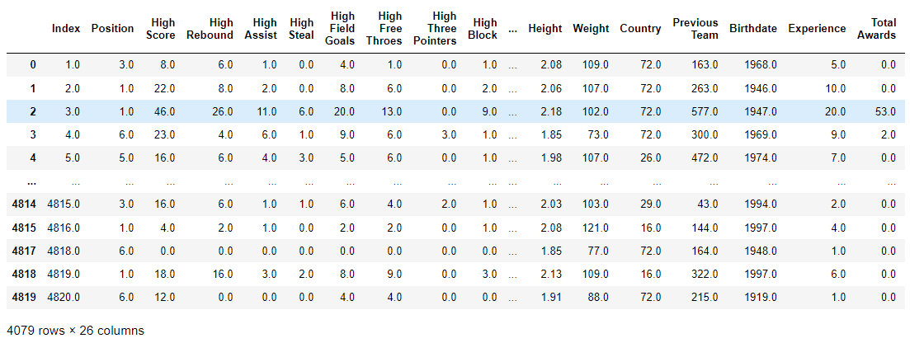
The DataFrame (after cleaning)

Slide 13

EDA Visualization
Create various graphical representations to understand the data better

Slide 14
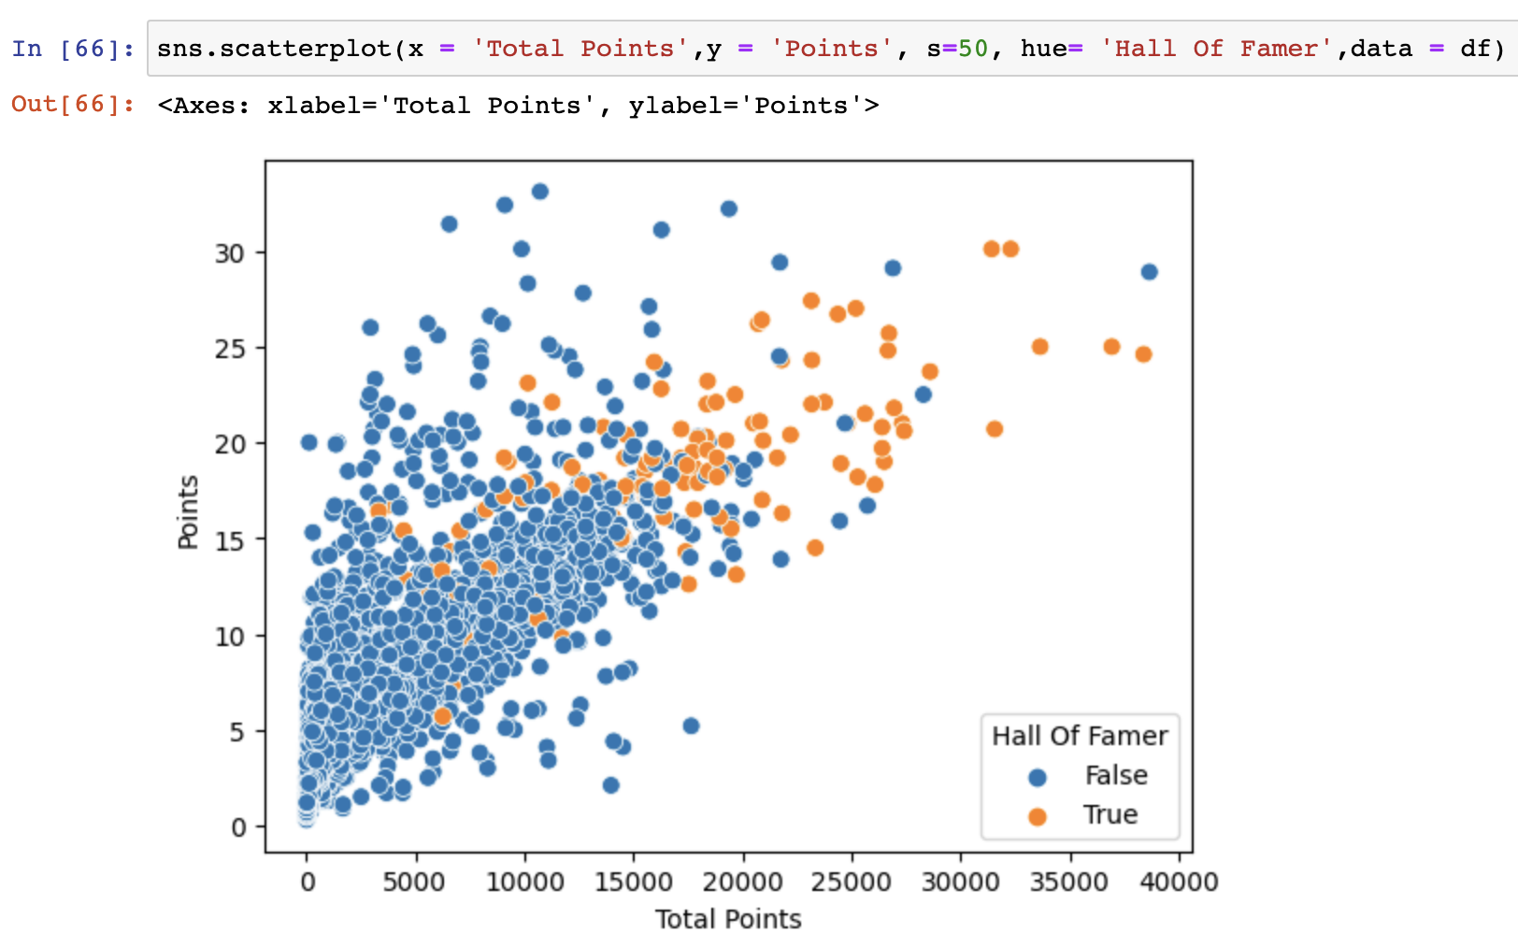
You can see there is a relationship between Total Points and Hall Of Famer
Total Points, Points (per season) – HOF vs non HOF

Slide 15
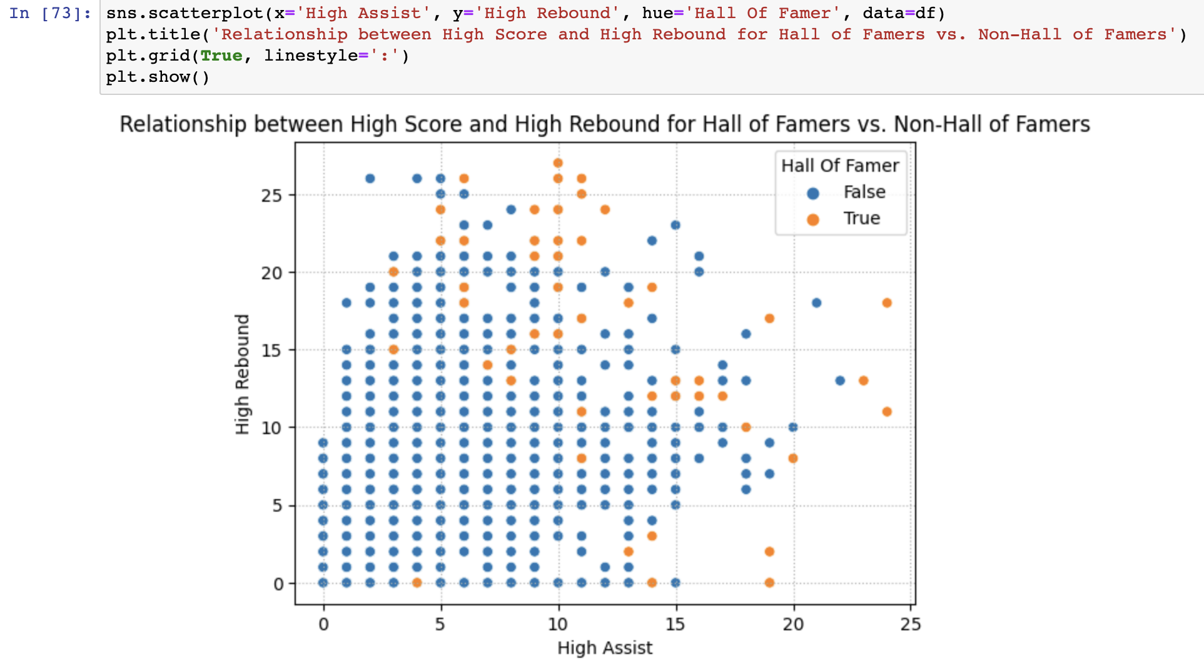
Can see that there is strong relationship between having a high number of career highs and being a Hall of Famer (they are mostly at the edges of the graph)
Career Highs – HOF vs non HOF
Relationship between high assist and high rebound for Hall Of Famers Vs. Non-Hall Of Famers

Slide 16
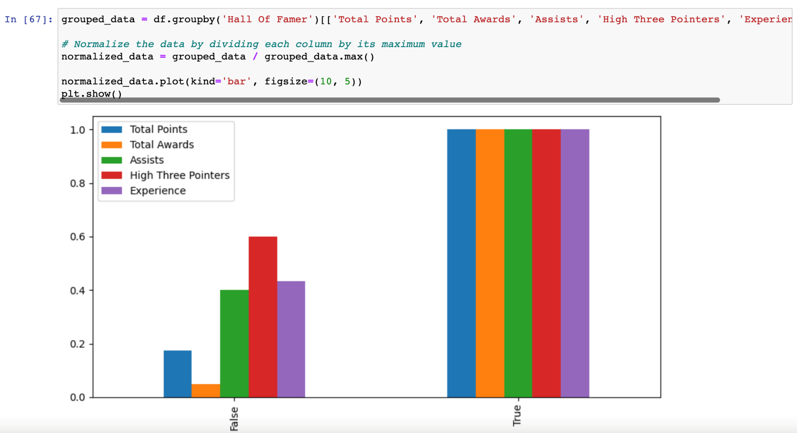
Averages of different parameters – HOF vs non HOF
Comparing the different columns using normalization
Can see that the difference in Total Awards and Total Points between HOF and non HOF is very significant
The difference in the High Three Pointers is insignificant

Slide 17
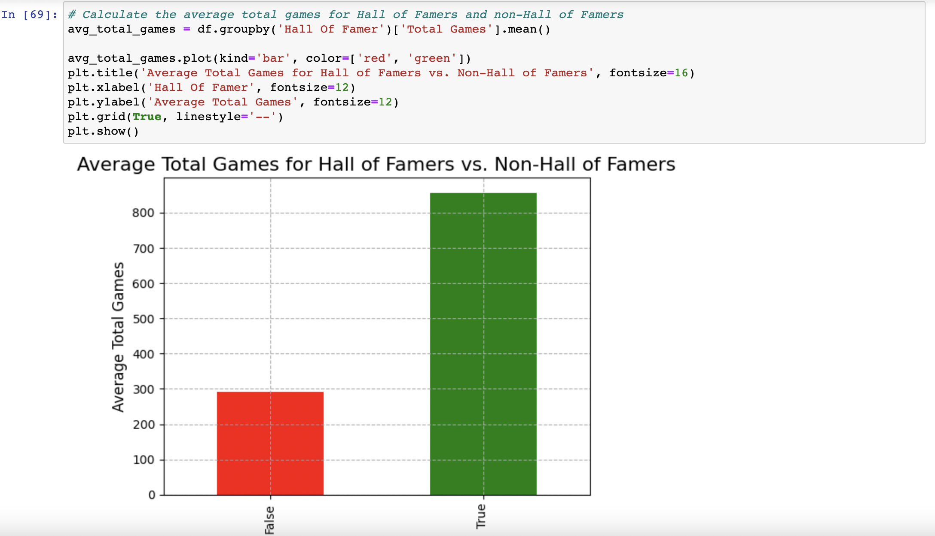
Averages of different parameters – HOF vs non HOF
The difference in Total Games between HOF and non HOF is quite significant

Slide 18
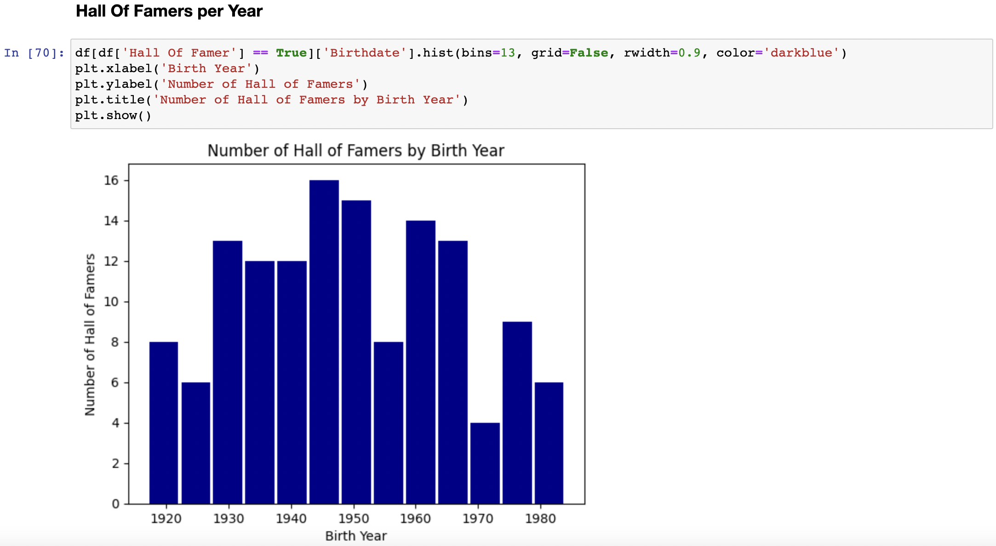
Hall Of Famers by Birth Year
Found out that all Hall of Famers were born between 1920-1980, which means that you must be over 40 years old to get into the Hall of Fame list

Slide 19
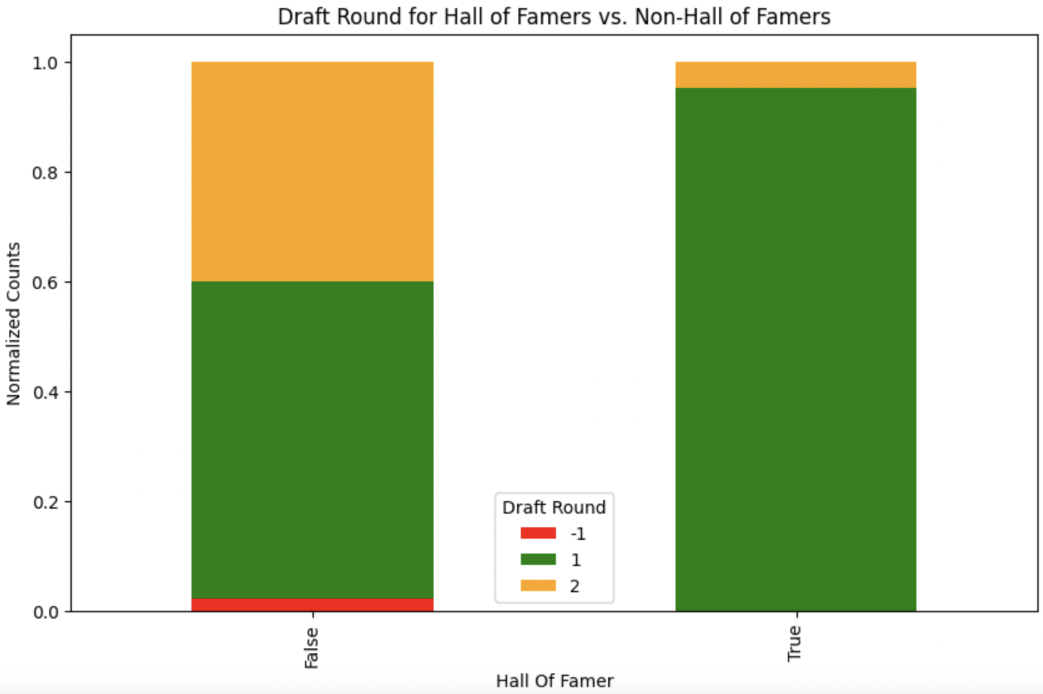
Draft Round – HOF vs non HOF
Can see here that vast majority of Hall of Famers were picked at round 1 of the draft and non of them were undrafted

Slide 20
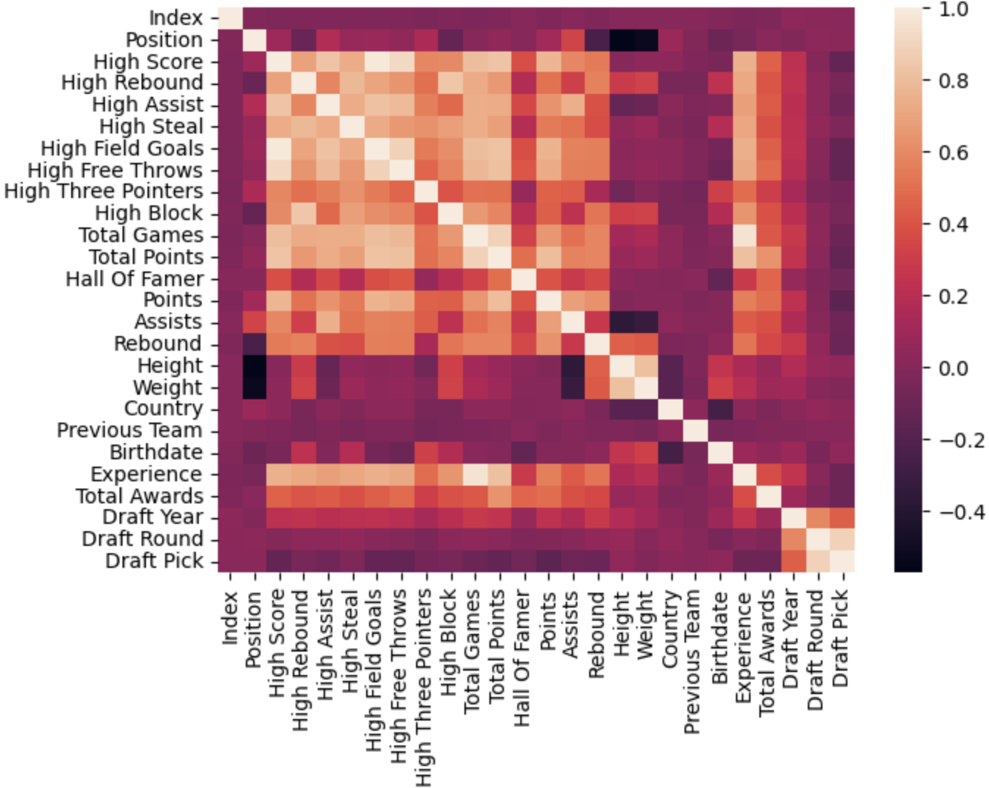
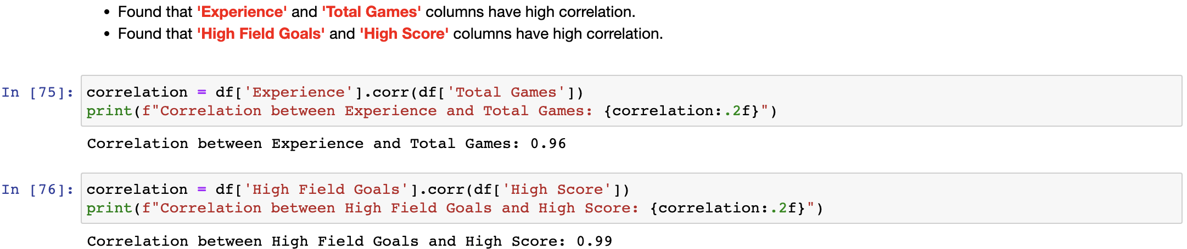
Heatmap
Found high correlation between Experience and Total Games
Found high correlation between High Field Goals and High Score
Dropped the ‘Experience’ and ‘High Field Goals’ columns to handle multicollinearity problem.

Slide 21

Machine Learning
Used sklearn to try different machine learning algorithms
Handling imbalance binary classification
Used feature importance

Slide 22
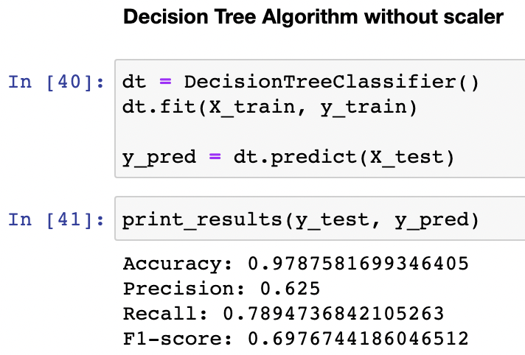
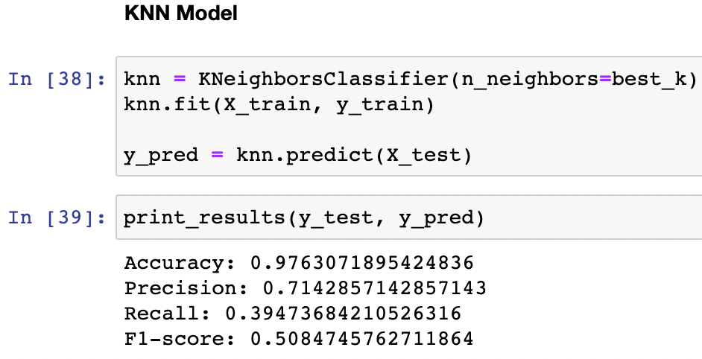
Examples before handling binary imbalance classification:

Slide 23
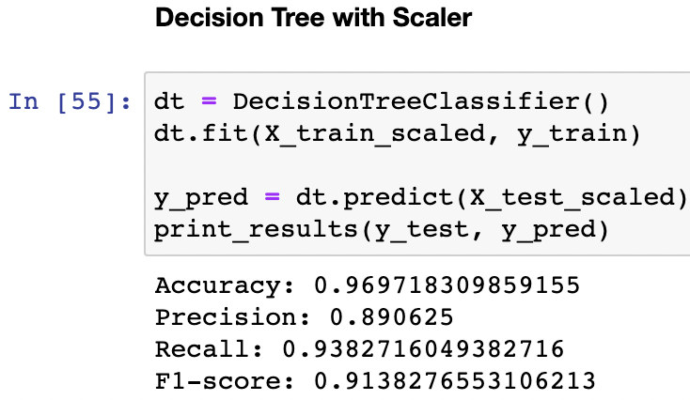
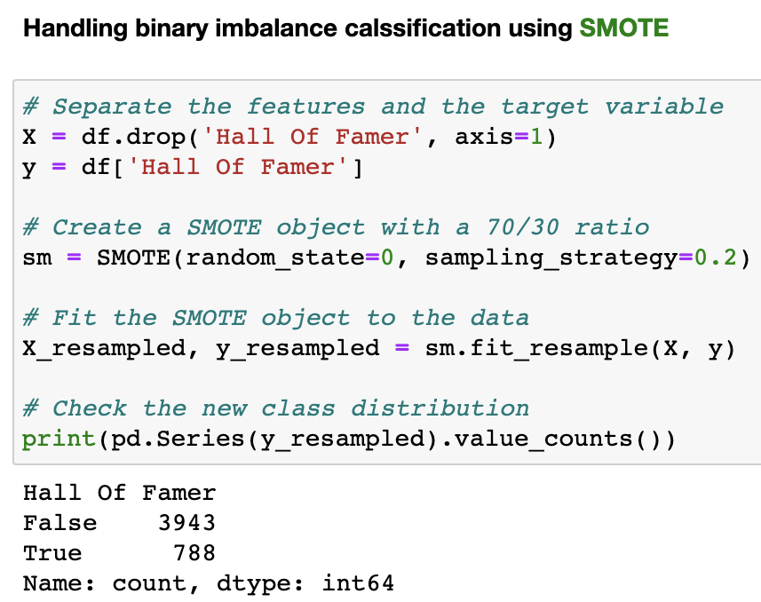
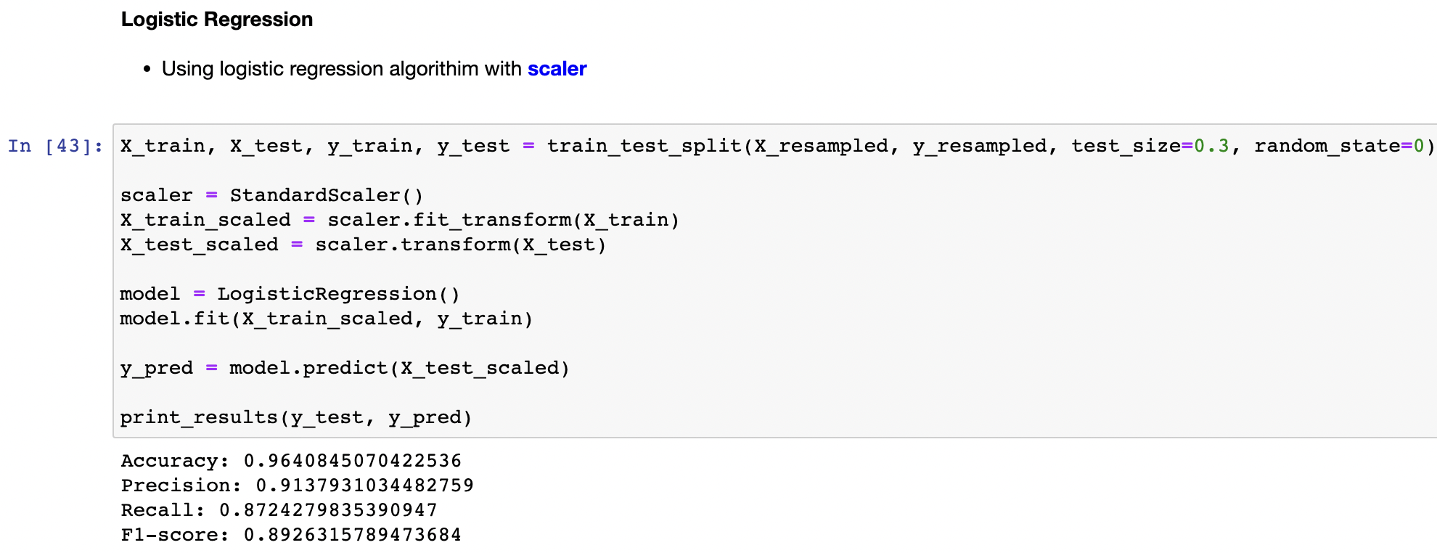


Examples After handling binary imbalance classification:

Slide 24
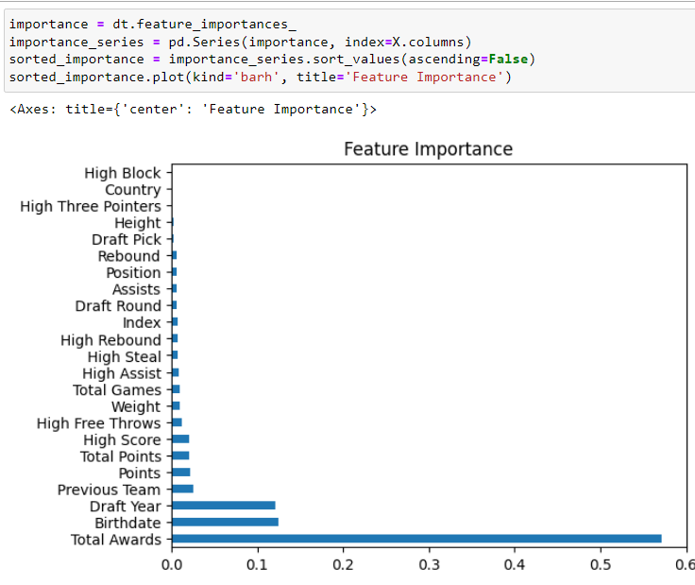
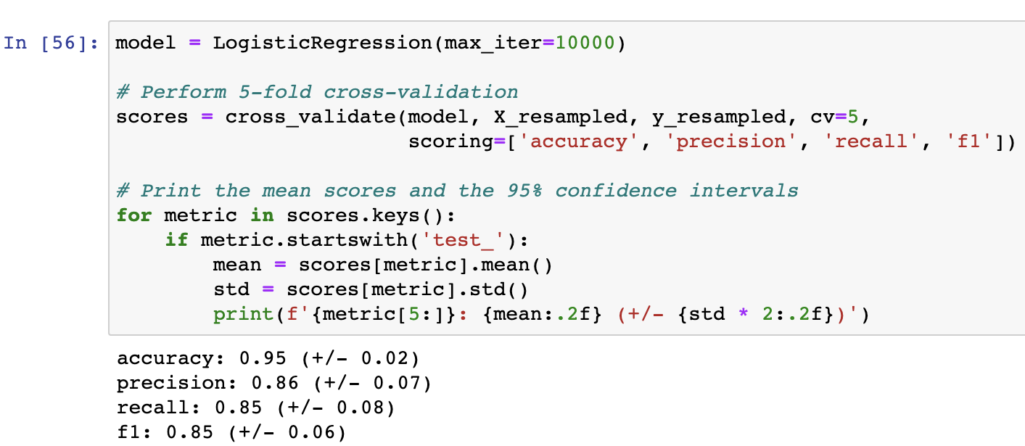
Feature Importance
Measuring the importance of each parameter in predicting a player’s chance at being a Hall of Famer
Cross Validation
Using 5-fold cross validation to confirm that there is no over-fitting in our model
As you can see the deviation is very small, which means that there is probably no overfitting and the model is performing well.

Slide 25

Summary
Our research question was: Can we find out if an NBA player will be selected for the Hall of Fame list?
During our project we:
Collected data about all the players that ever played in the NBA
Refined the data
Trained the machine using decision tree algorithm, and got a very good results
After doing all the above, we can conclude that it is indeed possible to predict whether a player will be selected to the Hall of Fame list.
To do so, we need a few key parameters: “High Score”, “Total Points”, “Points”, “Draft Year”, “Birthdate”, “Total Awards”.
Out of all the parameters, “Total Awards” has the greatest impact on the model’s predictions.
In conclusion, for NBA players aiming to secure a place in the Hall of Fame, a key factor to focus on is accumulating a strong record of awards, such as All-NBA selections, MVP titles, and All-Star appearances.

Slide 26
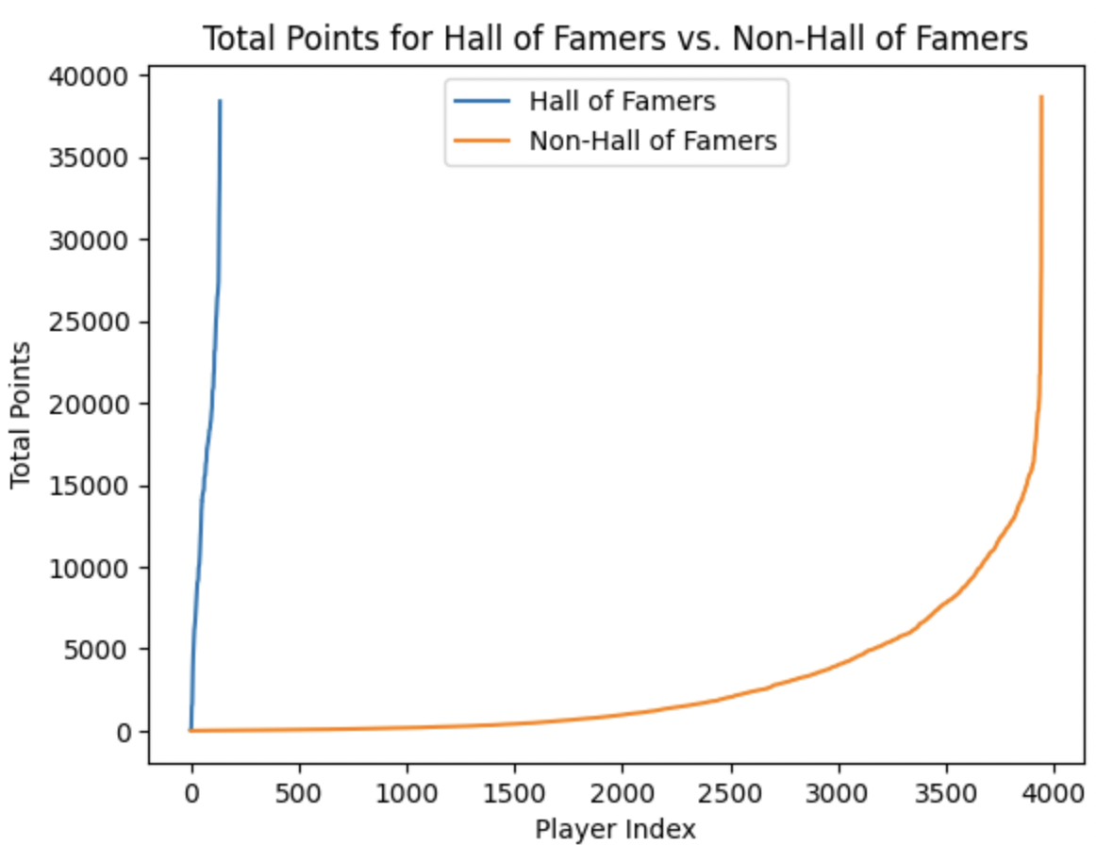
Total Points – HOF vs non HOF
A different way to view the significant difference between Hall of Famers and non Hall of Famers

